Slide 1

Sales Performance Dashboard – Power BI Project
Built using Sample Superstore Dataset
Submitted by: AINSLEY SVETA A

Slide 2
Objective
To design an interactive Power BI dashboard for business stakeholders that provides key insights into sales, profit, and performance trends, enabling data-driven decision-making.

Slide 3
Tools & Dataset
Tools Used:
Power BI Desktop
Dataset:
Sample - Superstore.csv
Contains fields like: Order Date, Sales, Profit, Quantity, Region, Segment, Category, Sub-Category

Slide 4
Key Performance Indicators (KPIs)
KPIs Displayed in Dashboard:
Total Sales
Total Profit
Quantity Sold
Profit Margin (Calculated using: Profit / Sales)

Slide 5
Dashboard and Its Features
Dashboard: https://github.com/AINSLEYANTONY/ELEVATELABSTASK04.git
Card visuals for KPI summary
Line chart for Sales over Time
Bar chart for Sales/Profit by Region & Category
Pie chart for Sub-Category contribution
Slicers for dynamic filtering (Region, Category, Segment, Year)
Consistent color theme for clarity and branding

Slide 6
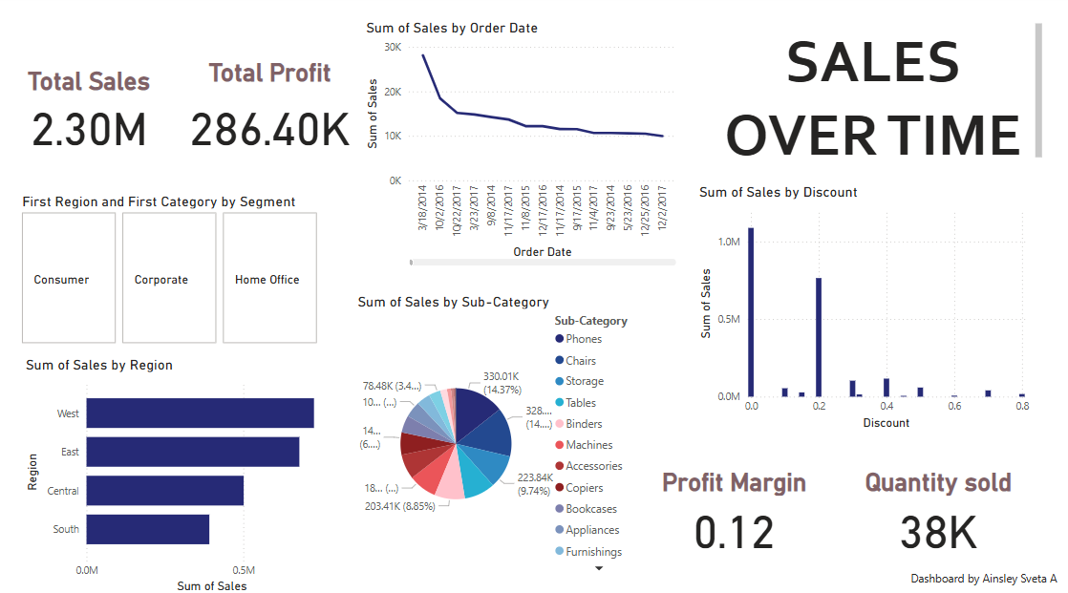

Slide 7
Key Insights
West Region shows the highest sales contribution
Technology is the top-performing product category
Tables sub-category has high sales but low profit margins
Sales show seasonal variation, with spikes during specific quarters

Slide 8
Conclusion
The Power BI dashboard enables stakeholders to monitor
sales performance and profit trends in real time.
It supports actionable decisions through visual insights and interactivity.

